Slide 1
Phishing for You and Your Grandma!

Slide 2
whoami
Pentester at TrustedSec
Graduated from Utica College in Cybersecurity & Forensics
First time speaking at DerbyCon
@snorrisponydeer
@meme_pwnie
Notes:
Who is this talk for? This talk is for anyone who maybe hasn’t done a ton of phishing campaigns and wants to know what some common roadblocks are and how to be more successful.

Slide 3
Phishing is Easy Tho
Notes:
Phishing sounds easy, but It's not always. So here are some things that can make your life easier.

Slide 4
What is Needed?
Creation of a Pretext With IMPACT and Urgency!!!
An Effective Payload
A Convincing Phishing Site
Successful Delivery of the Email (NOT )

Slide 5
Notes:
So imagine that you picked a target, you made a super convincing pretext, and then you wait for the shellz and creds to roll in, but they don’t…..so what happened?
At this point there are a lot of things that could of happened. Your email likely didn’t make it to the targets inbox.

Slide 6
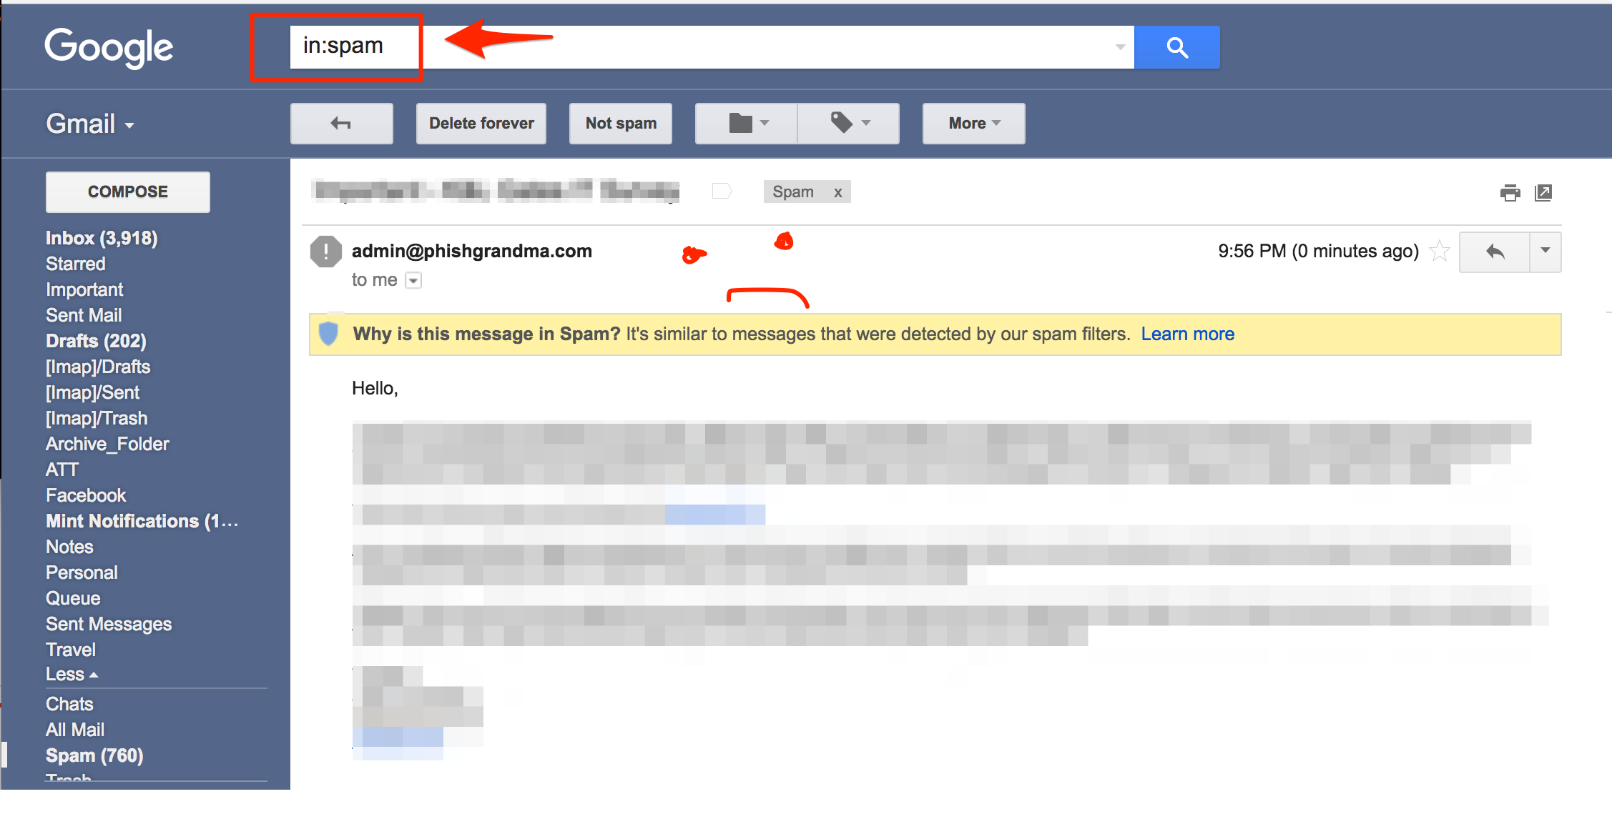
Why Come?
Notes:
Also before you start diving into why the email didn’t make it to your targets inbox make sure that the domain isn’t blacklisted, and that the IP that your mail server on isn’t blacklisted. You can check this on Mxtoolbox.com

Slide 7
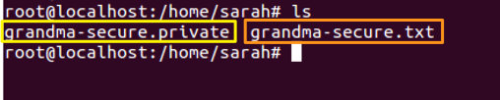
Make a DKIM Key
https://sourceforge.net/projects/opendkim/files/
Notes:
So our domain isn’t blacklisted but it seems like Gmail doesn’t trust us! So lets try to authenticate ourselves as a sender. OpenDKIM is an open source implementation of the DKIM (Domain Keys Identified Mail) sender authentication system proposed by the E-mail Signing Technology Group (ESTG), now standardized by the IETF (RFC6376).

Slide 8
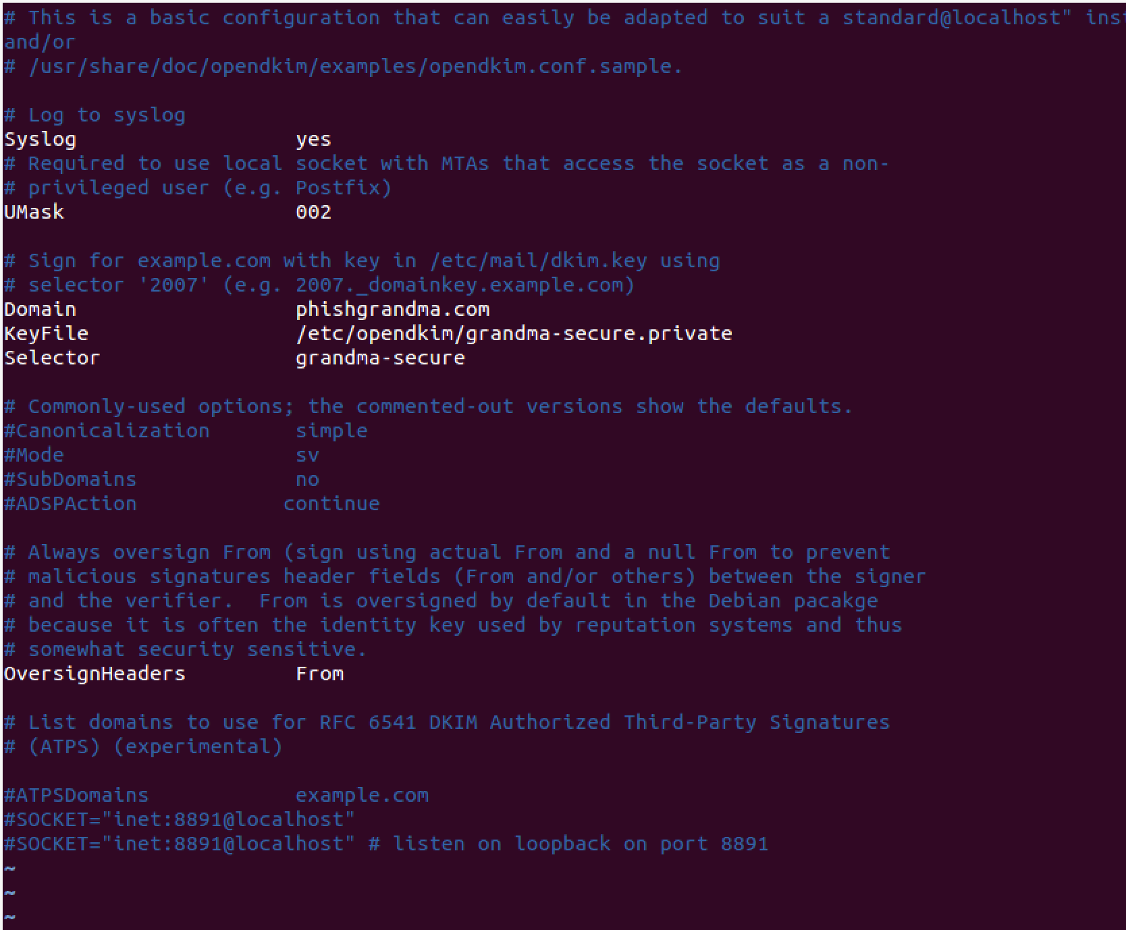
Edit ‘etc/opendkim.conf’

Slide 9
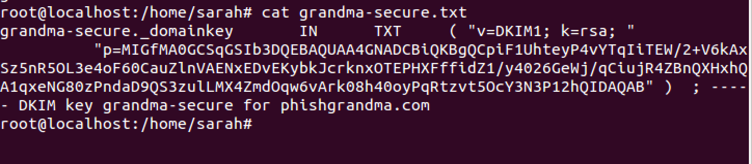
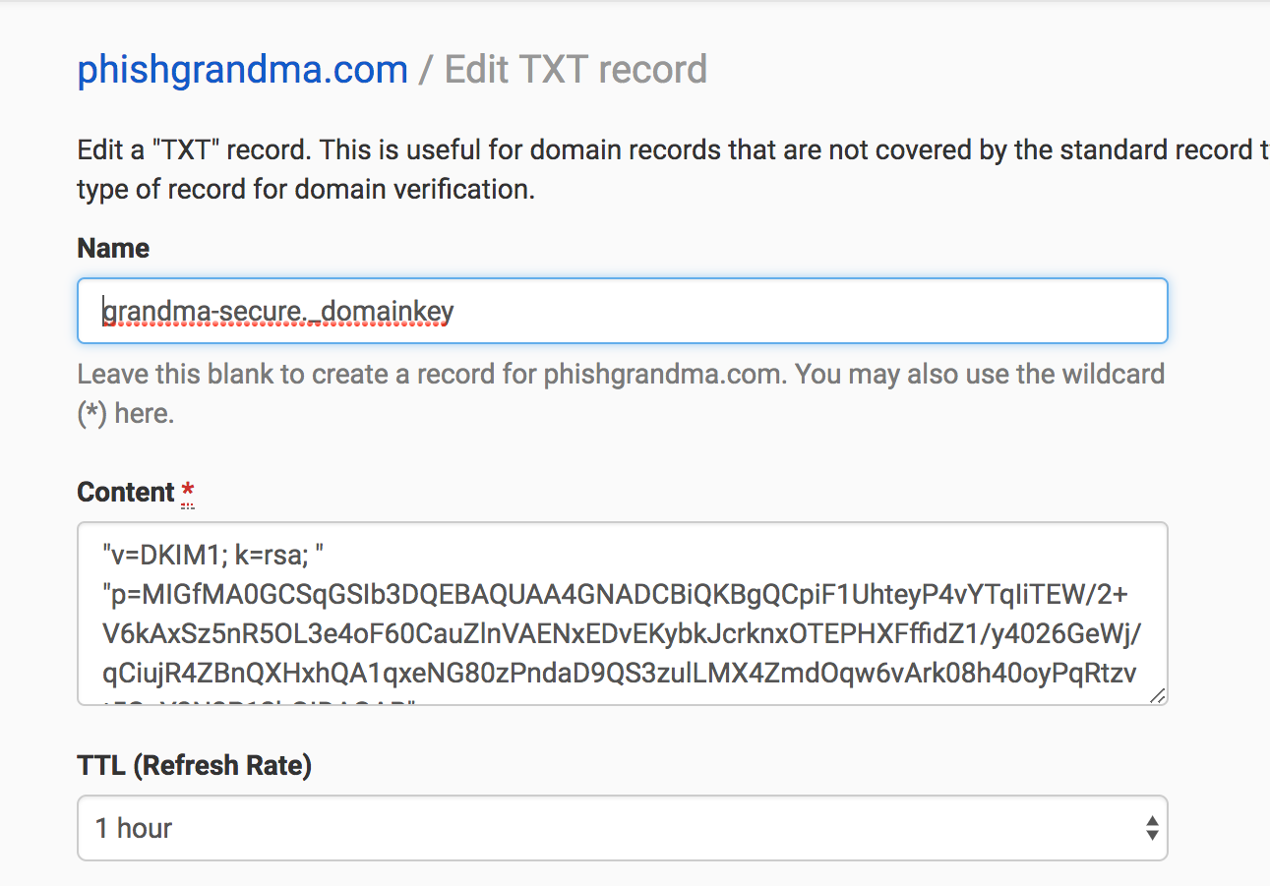
Add DKIM Key to DNS

Slide 10
Notes:
This is a good time to

Slide 11
Other Necessary DNS Records
A
MX
SPF
DMARC (This doesn’t work without DKIM)

Slide 12
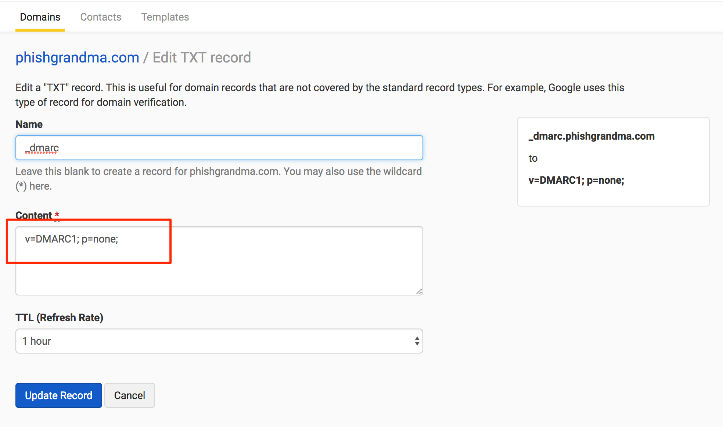
DMARC
Notes:
At the minimum for DKIM you need to specify the version and the policy, but as long as you have those it will work with DKIM to validate you as a sender.

Slide 13
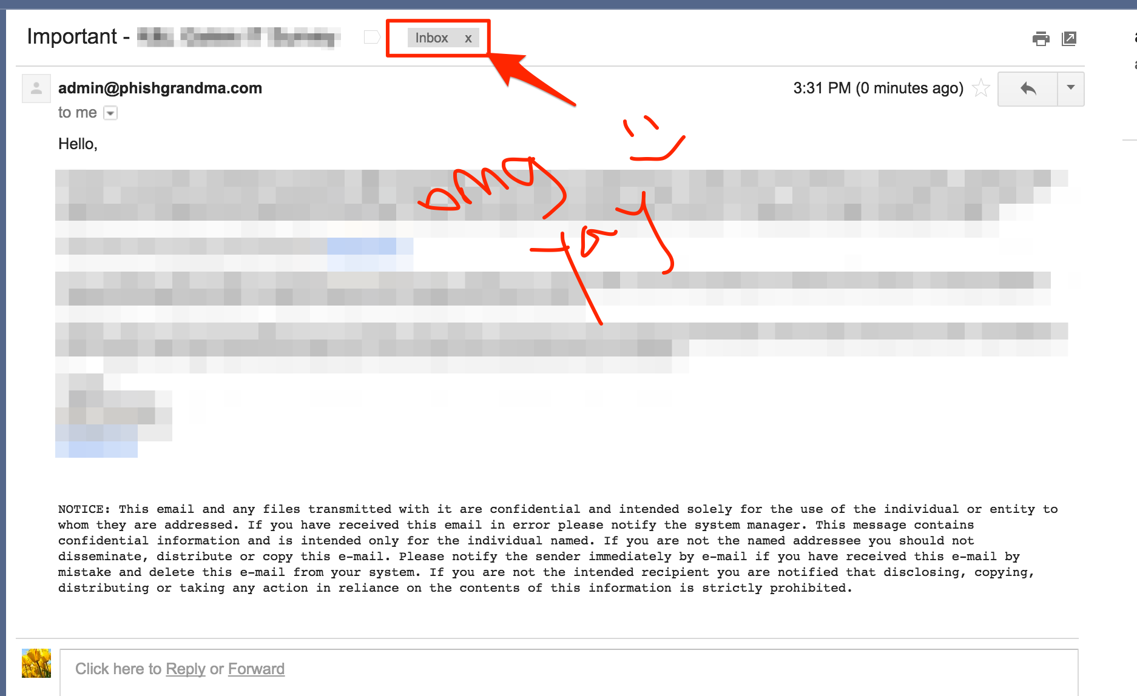
I Kno You!

Slide 14
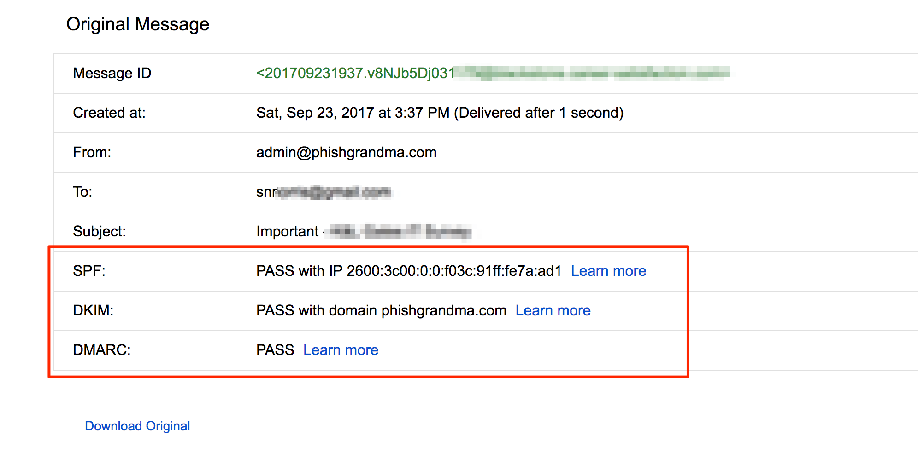
I Kno You!

Slide 15
You win!

Slide 16
We’re In(box), Now What?

Slide 17
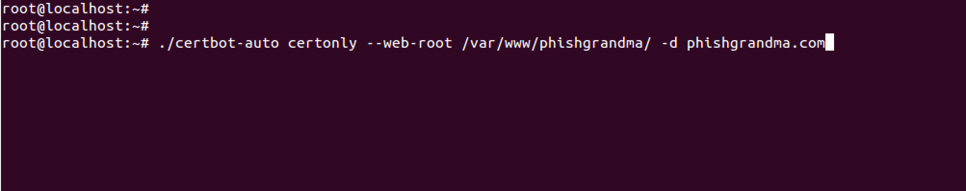
Get An SSL Cert
Lets assume target uses proxy for outbound traffic…certificate pinning is our friend!

Slide 18
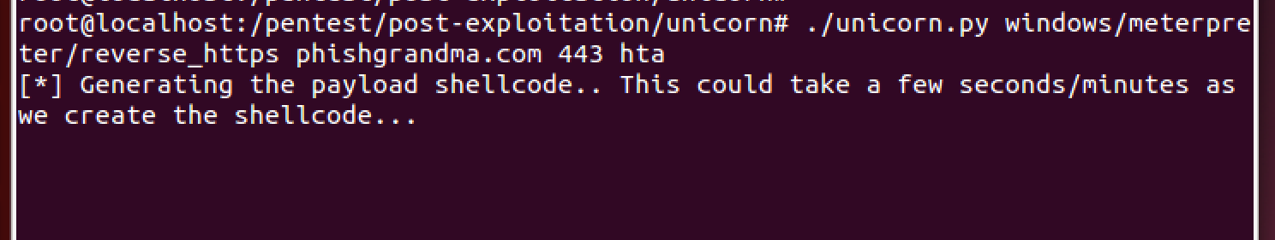
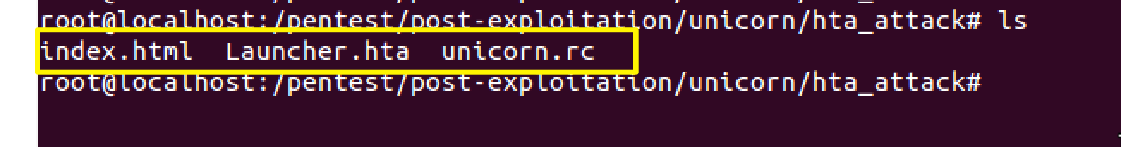
Set The Payload Up

Slide 19
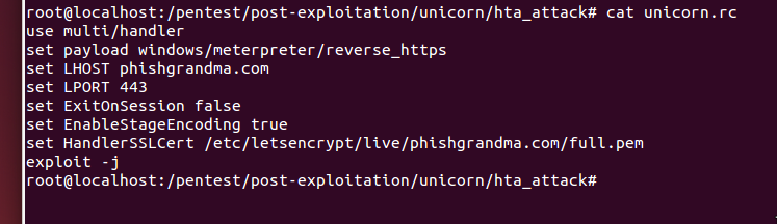
Set Up the Handler
Notes:
So once you have the handler running, you can verify your connections with openssl or a browser, and if all goes well you’ll get some shellz from your target.

Slide 20
Resources For Pretexts
Open Court Cases
(https://dockets.justia.com/search?parties=<TARGET>)
News about/relevant to the target
Events that target is participating in
If corporate, anything that might impact the target (employee).

Slide 21
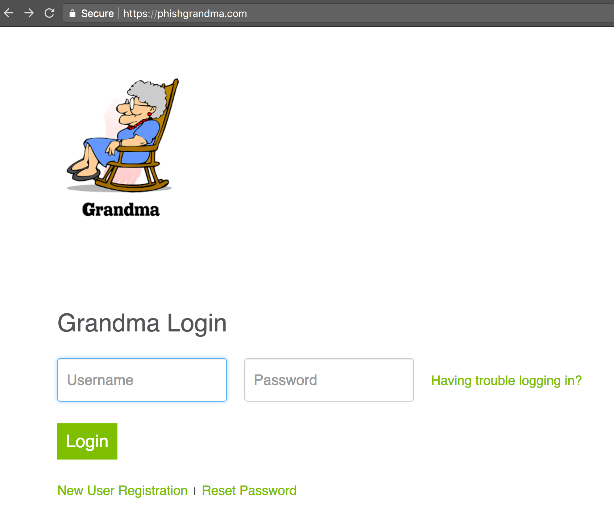
Make your Phishing Site

